Slide 1
Keylogger and security
Student name : Annam Balaji

Slide 2
Table of contents
Introduction to keyloggers
How keylogger works
Methods of keylogger distribution
Detection and prevention
Security
Modelling
Advantages and Disadvantages
Algorithms used in Keyloggers
Result
Project link

Slide 3
INTRODUCTION TO KEYLOGGER
Keyloggers - A keylogger is a type of surveillance software or hardware designed to record keystrokes on a device without the user's knowledge.
It captures keystrokes entered on a keyboard, which can include sensitive information such as passwords, credit card numbers, and personal messages.
Security -Security refers to the protection of computer systems and networks from unauthorized access, attacks, and damage to hardware, software, or electronic data.
Types :
Software Keyloggers:
Malicious programs covertly installed on computers to record keystrokes and compromise sensitive information.
Hardware Keyloggers:
Physical devices installed between keyboards and computers to intercept and record keystrokes, evading software detection.

Slide 4
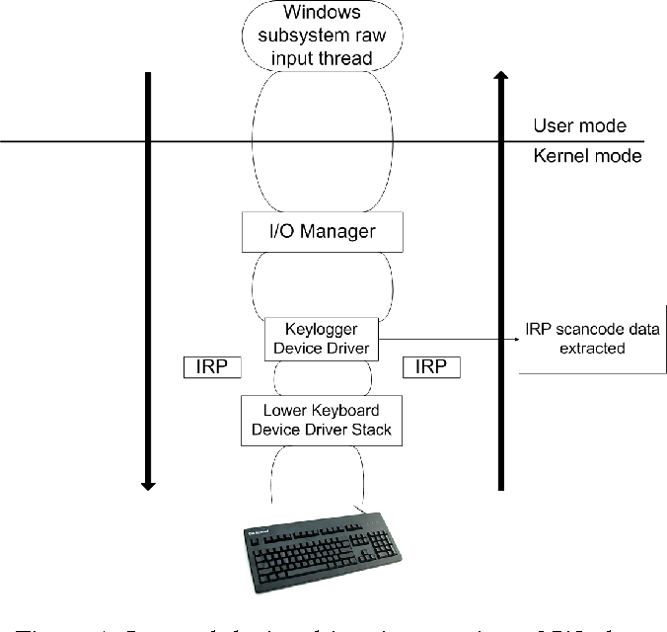
HOW KEYLOGGERS WORK?
Keyloggers record keystrokes on a device by running silently in the background or intercepting signals between the keyboard and computer. Software keyloggers are installed as malicious programs, capturing and storing keystrokes in log files, while hardware keyloggers are physical devices that intercept keyboard signals directly. Captured data is either stored locally or transmitted to remote servers controlled by attackers.

Slide 5
METHODS OF KEYLOGGER DISTRIBUTION :
1.Malicious Websites
Description: Websites that host malicious code can exploit browser vulnerabilities or trick users into downloading and running keylogger software.
Example: A website offering free software or cracked versions of paid software that secretly includes a keylogger.
2.Bundled with Software
Description: Keyloggers can be bundled with legitimate software and installed alongside the primary application without the user’s explicit consent.
Example: Free software downloaded from unofficial sources that includes a keylogger in the installer package.
3.Removable Media
Description: Keyloggers can be distributed via USB drives, CDs, DVDs, or other removable media.
Example: An infected USB drive left in a public place or handed out as a promotional item that installs a keylogger when plugged into a computer.

Slide 6
DETECTION AND PREVENTION :
Detection : Detecting keyloggers requires a combination of methods including using anti-malware software, conducting regular security scans, and implementing behavioral monitoring. These approaches help in identifying and mitigating the risks associated with keylogging malware.
Anti-Malware Software
Regular Security Scans
Behavioral Monitoring
Prevention :Preventing keyloggers involves adopting proactive measures such as practicing safe internet habits, regularly updating software, and employing encryption technologies. These steps help mitigate the risks of unauthorized keystroke monitoring and data theft.
Use Virtual Keyboards
Multi-Factor Authentication (MFA)
Monitor System Activity

Slide 7

SECURITY:
Ensuring robust security is paramount in preventing keylogger attacks. Key security measures include deploying advanced anti-malware software to detect and remove keyloggers, keeping all systems and applications up-to-date with the latest security patches, and implementing multi-factor authentication (MFA) for an added layer of protection. Additionally, educating users on safe online practices and monitoring system behavior for any unusual activities can significantly reduce the risk of keylogger intrusions. By integrating these comprehensive security strategies, we can safeguard sensitive information and maintain a secure computing environment.

Slide 8
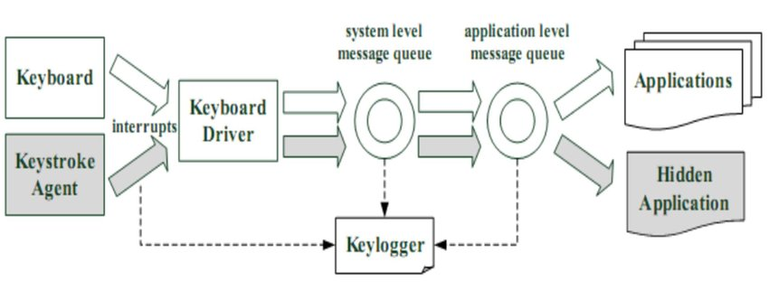
MODELLING :
END USERS:
Individuals
Businesses
Financial Institutions
Government Agencies

Slide 9
Advantages and Disadvantages
Advantages:
Disadvantages:
Monitoring and Surveillance
Parental Control
Password Recovery
Law Enforcement
Debugging
Privacy Concerns
Malware Threat
Legal Issues
False Sense of Security
Detection and Removal Challenges

Slide 10
Algorithms Used in Keyloggers:
1.Keystroke Logging Algorithms:
Hooking APIs
Polling
Keyboard Event Monitoring
2.Data Encoding and Transmission:
Encryption
Base64 Encoding:
3.Stealth Techniques:
Process Injection
Rootkit Techniques

Slide 11
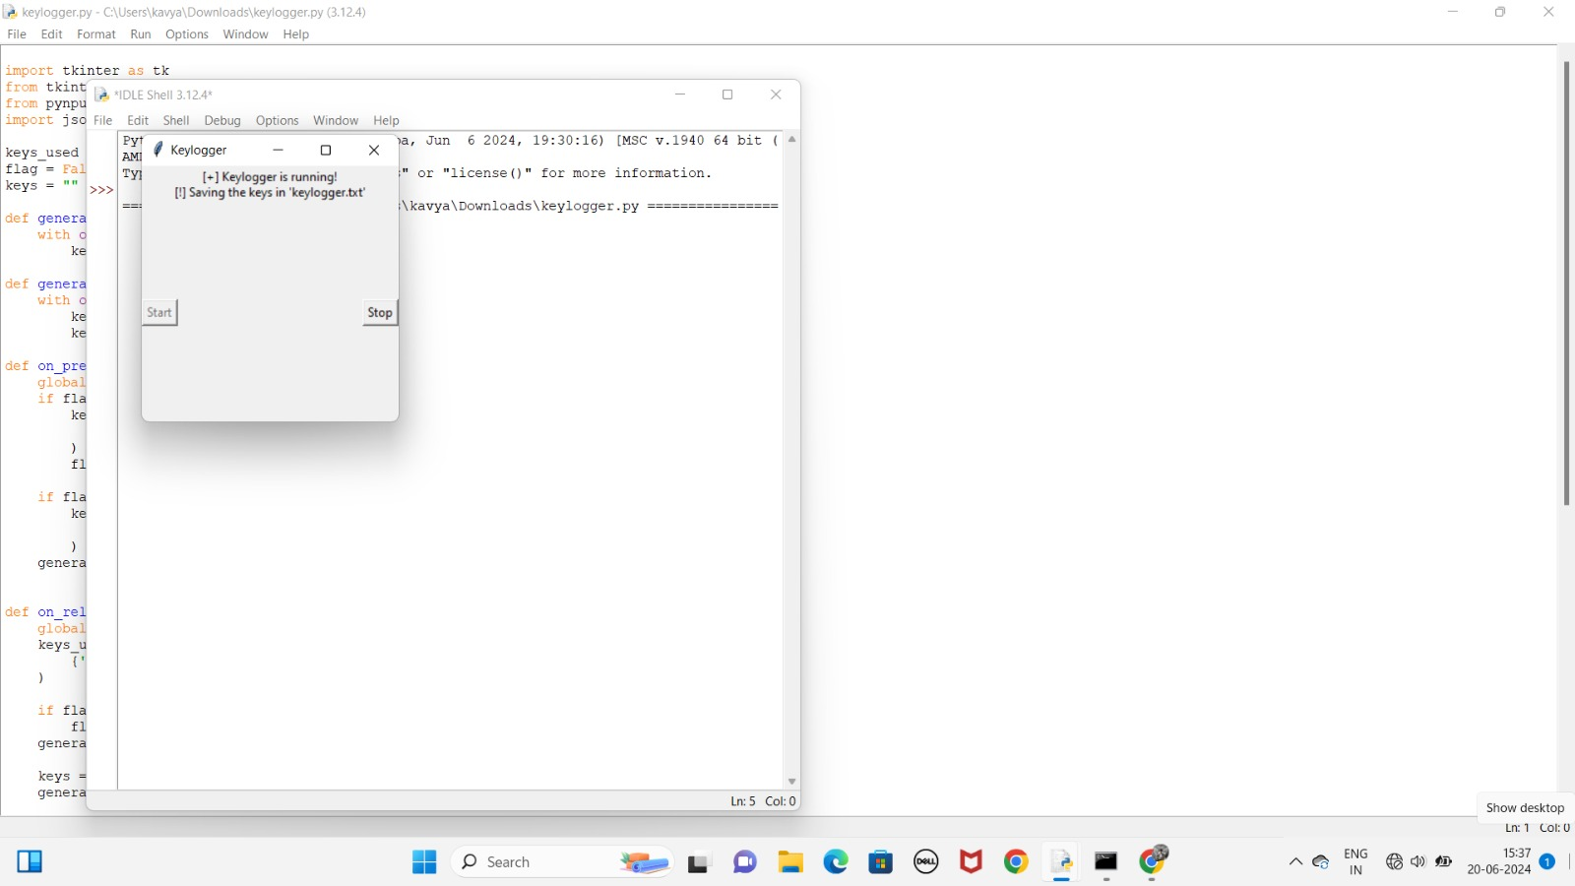
Result

Slide 12
Project link
https://github.com/balaji-151104/annam-balaji.git

